Slide 1


Take back your time! Let AI do the work for you
Eldert Grootenboer

Slide 2


Eldert Grootenboer
@egrootenboer

Slide 3
Take back your time!
Time is precious
Wasted on repetitive tasks
Less time for innovation
Same task over and over
Risk for human error
Hard to maintain security and governance

Slide 4
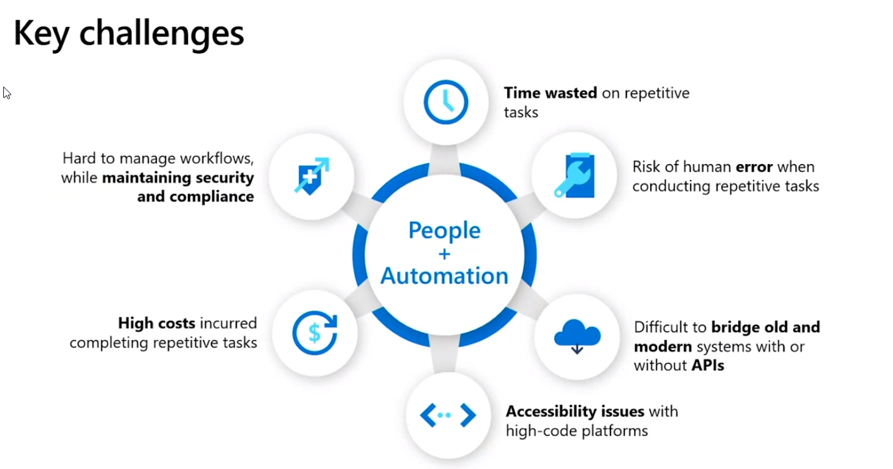

Slide 5
25% of tasks that can be automated, will be automated by 2024

Slide 6
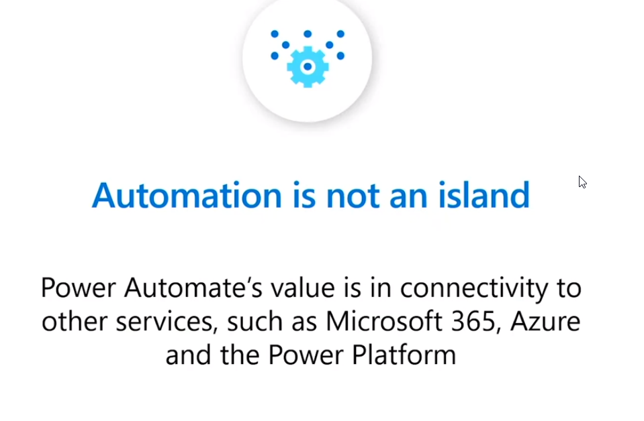

Slide 7

people within the organization need to be empowered…

Slide 8
PowerApps
Power BI
Microsoft Flow
Dynamics 365
Microsoft
Power Platform
Azure
Office 365
Standalone Apps
Common Data Service for Apps
Data Connectors

Slide 9



Microsoft Power Platform
The low-code platform that spans Office 365, Azure, Dynamics 365, and standalone applications
Innovation anywhere. Unlocks value everywhere
Power BI
Business analytics
Power Apps
Application development
Power Automate
Process automation
Power Virtual Agents
Intelligent virtual agents
Data connectors
Common Data Service
AI Builder
Notes:
To help empower your people and elevate their talents, Microsoft combined the capabilities of three services into a unique and powerful low-code development platform. While the Power Platform has capabilities which will impress any seasoned developer, it is designed to be approachable and accessible to those in the best position to identify transformative applications – those who work on the front lines of a business.
Digital transformation means more efficient use of your data to gain insight which facilitates more intelligent business processes and decision-making. However, organizations cannot achieve this efficiency with only programmers, data scientists, and tech professionals because there simply are not enough of them. One of the foundational goals of the Power Platform is to empower the limitless potential of citizen developers who can use its capabilities to unlock insights and develop processes that would otherwise never surface.
The Power Platform is a singular low-code platform that spans Office 365, Dynamics 365, Azure and standalone applications.
Today we’re going to dive deeper into Power Automate which is Microsoft’s service that enables automation for all and serves as a crucial component of the Power Platform.

Slide 10
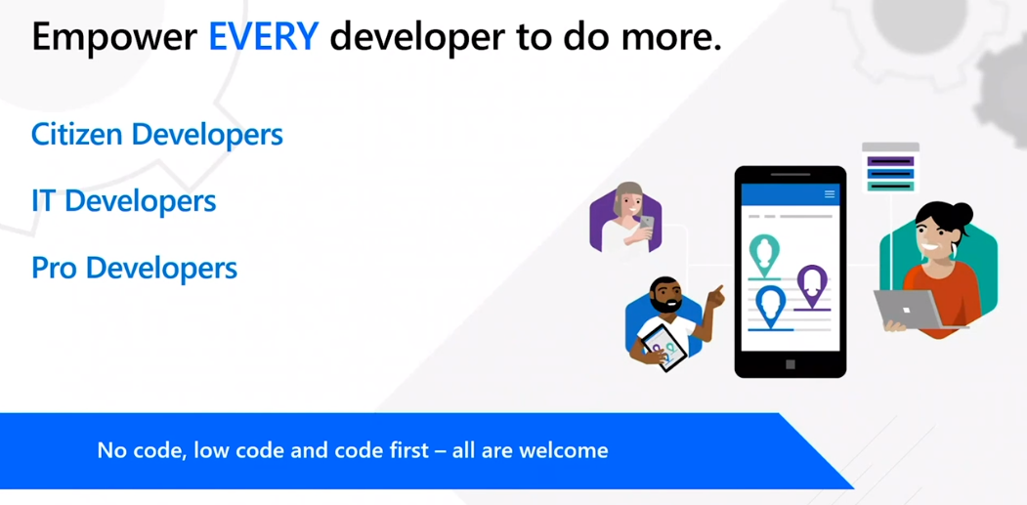

Slide 11
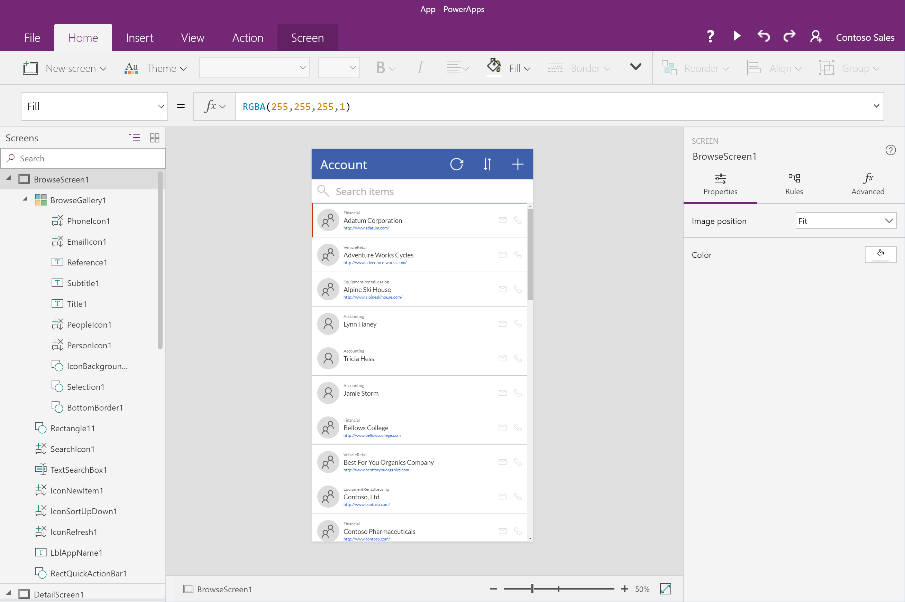

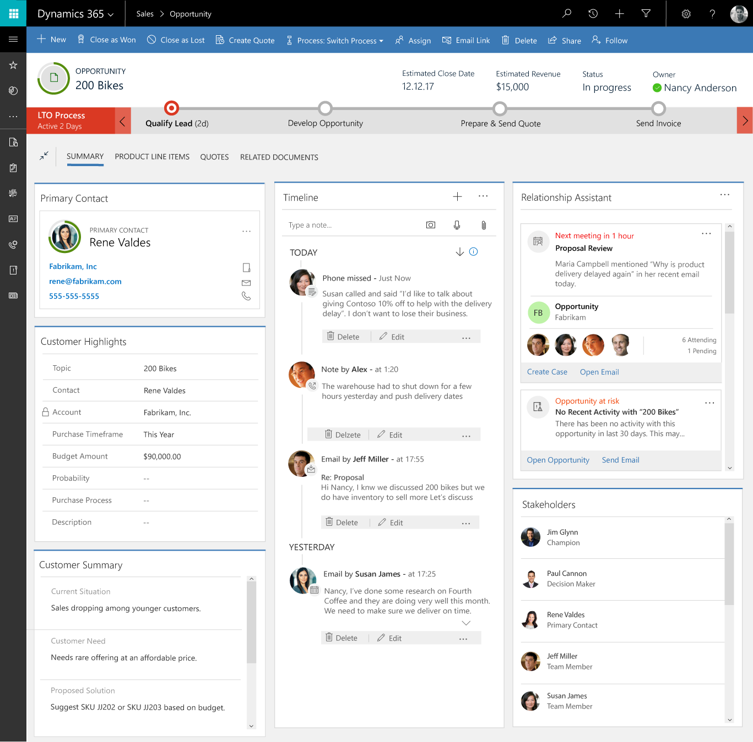
PowerApps Rich, WYSIWYG canvas-based authoring
Rich canvas-based authoring Full creative freedom to place controls and craft user experiences with a PowerPoint-like canvas
Ability to create app logic with familiar Excel-like expressions and to mash up data from multiple sources right at the app level
“True WYSIWYG”: use the app while building it Creators work with live data and can directly use the app as they work, getting instant feedback
Template apps for phone, tablet, and web Pre-built apps covering common business development scenarios across devices and form factors
Create apps around forms and processes Model Driven apps allow fully metadata driven applications revolving around forms and business processes
Design sophisticated entity forms quickly Drag and drop fields and controls in a visual designer. Forms can span multiple columns, multiple steps, and collapsible sections.
Rich, responsive client experiences Responsive UI automatically reflows across devices based on the space available.
Immersive integrations Use Excel, Word, OneNote, Microsoft Social Engagement, Power BI, LinkedIn, and more directly embedded.
Sophisticated apps built from data

Slide 12
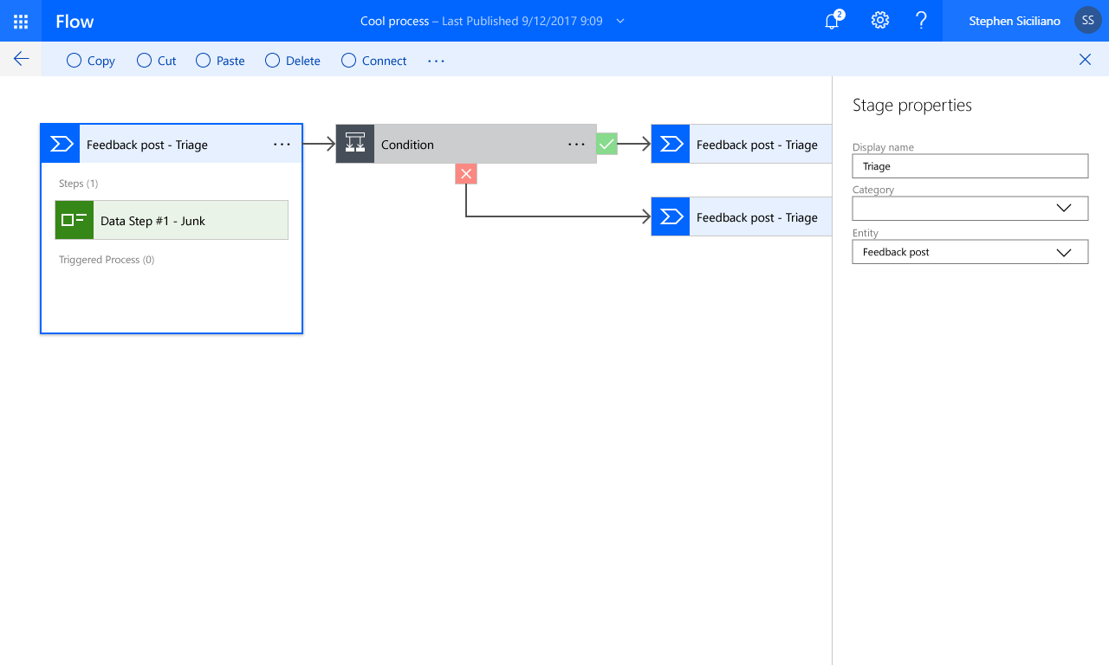
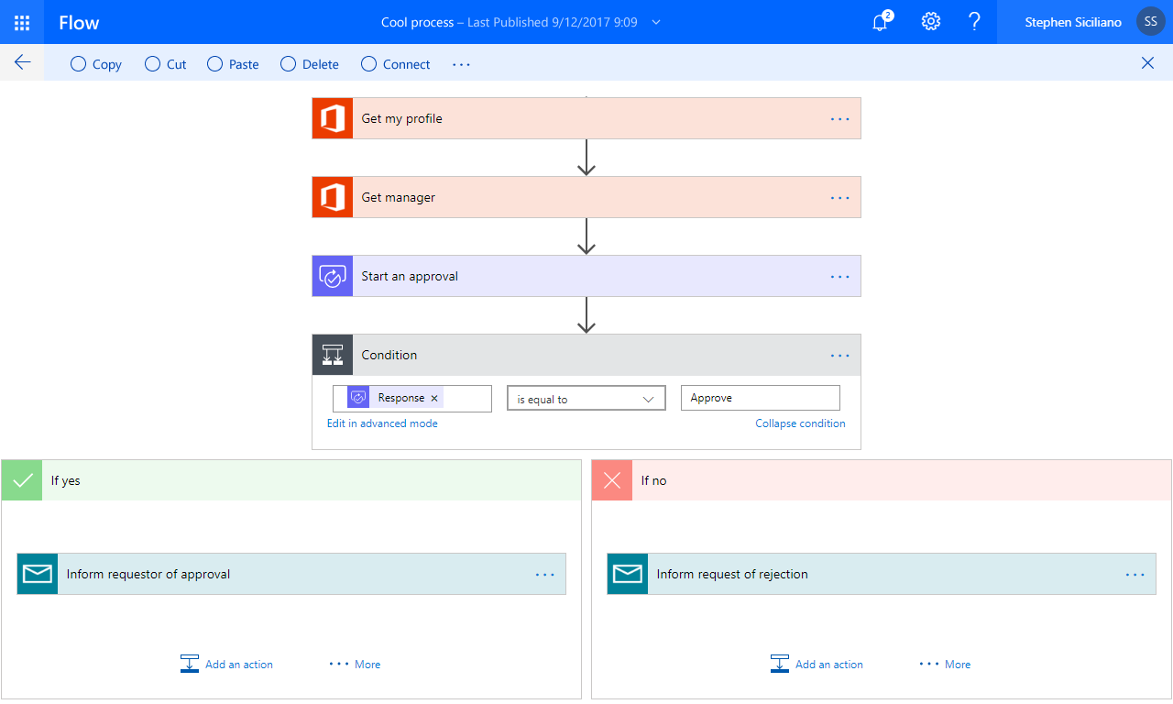
Microsoft Flow Connecting Apps & Services
Automate and model business processes across your apps and services
From simple automations to advanced scenarios with branches, loops, and more
Trigger flows from apps based on user interaction, data changes or events
Leverage device signals on mobile devices
Supports 230+ data sources for events and actions, from Microsoft and other vendors
Design Flows in MS Visio
Flow bot for Microsoft Teams
Power Query integration

Slide 13

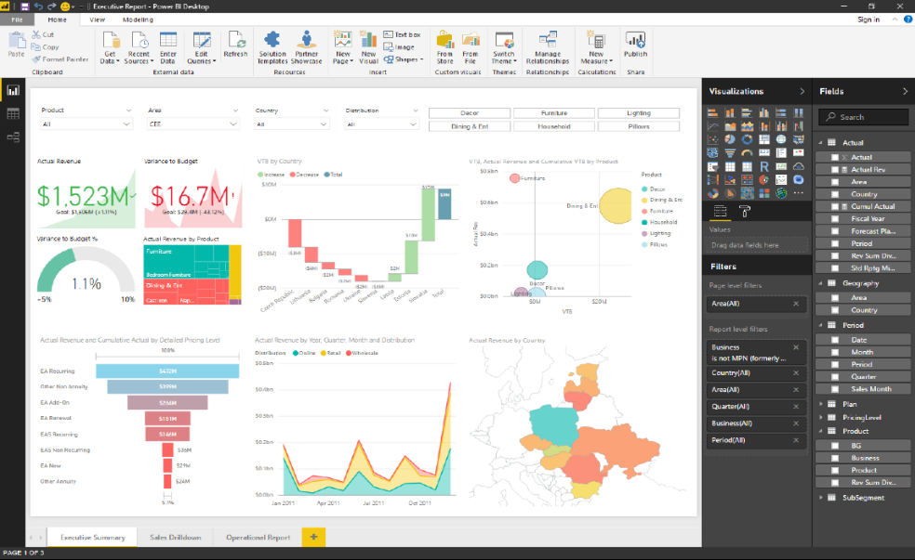
Power BI Create stunning interactive reports
Author reports using 150+ visuals via a drag-and-drop canvas
Explore data across multiple interactive visualizations
Provide insights in the context of your business with Custom Visuals
Visualize your data story with bookmarks and custom navigation

Slide 14
Why PowerApps and Flow?
Time
Resources
Price
Data
Maintenance

Slide 15
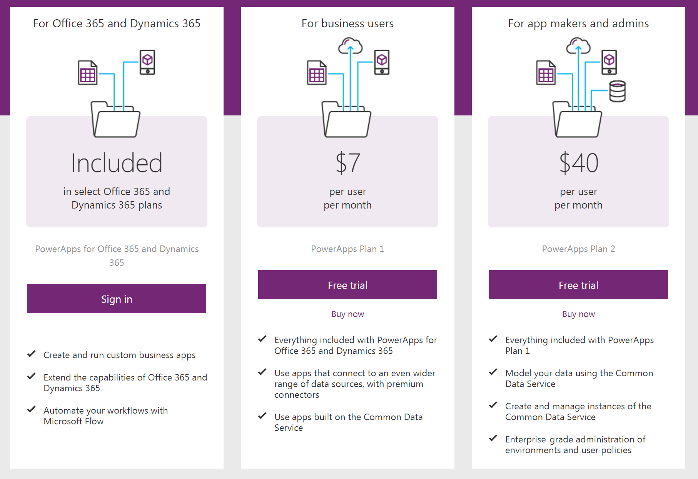

Slide 16


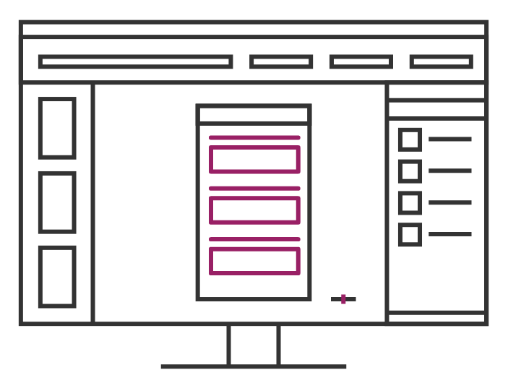
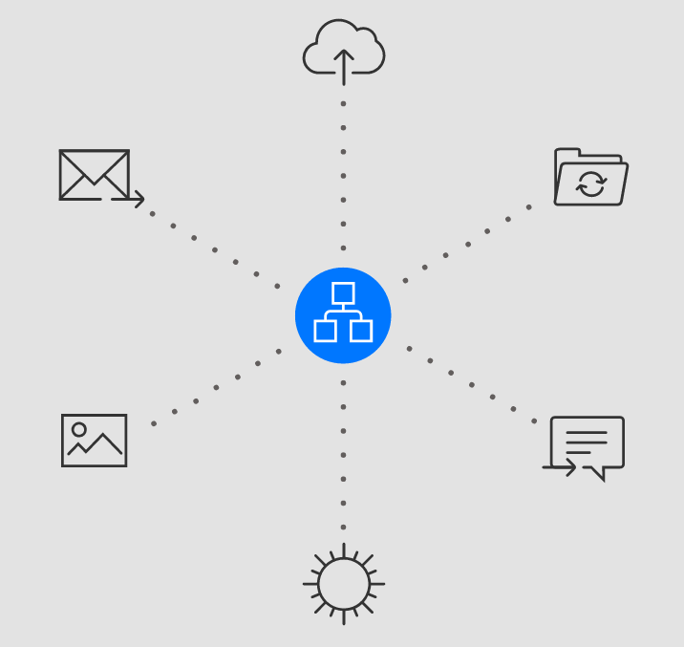
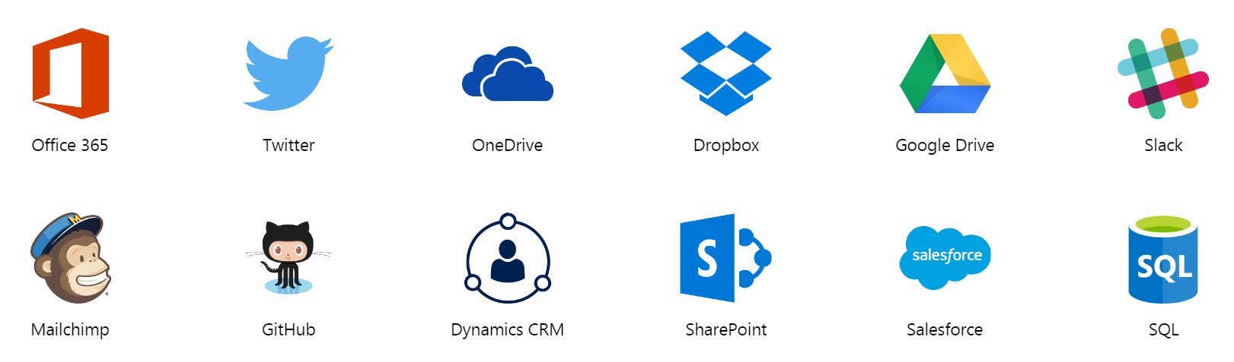
PowerApps, Flow and Connections

Slide 17
Power Automate is Designed For Everyone
Power Automate is the automation service for everyone in your organization
End Users
Experienced Developers
IT/Admins
Notes:
Importantly, Power Automate is automation for all. Power Automate is designed for ease of use for business or departmental users, the world’s growing citizen developer community, yet also offers the functionality required for experienced developers. Power Automate is also built to support the needs of modern IT teams and Admins, from automating mundane IT functions, to providing security, compliance, and control over the usage and execution of Power Automate across the IT ecosystem.
Power Automate can be used to do simple tasks such as scheduled delivery of emails, to seamlessly integrating with enterprise apps, to enhancing and automate processes that are cumbersome for IT admins.
End Users
Understand the business
Solve their own problems
Professional Developers
Use code to unblock complex requirements
Reduce time to develop and deploy
IT Professionals
Automate mundane IT functions
Automation that is security and compliant
Offers visibility and control to help ensure governance

Slide 18
Low code
Lower barrier to entry – User interface guides experience
Speed - Faster iteration by drag-and-drop
Debuggability - Ability to see full execution history
Documentation – Easier for other people to pick it up

Slide 19
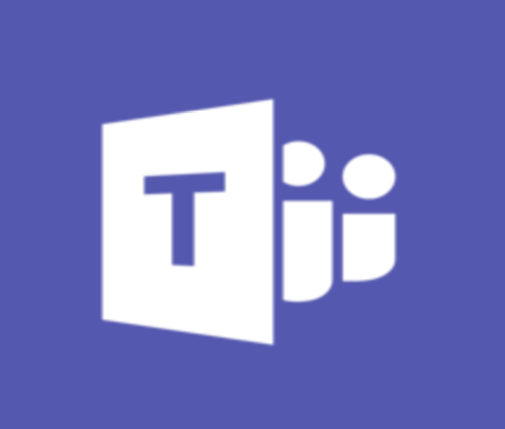
300+ connected experiences
Connect to more than 300+ 1st and 3rd party services with built-in connectors for everything from Adobe to Zendesk to on-premises solutions
Notes:
Not only is Power Automate a part of the robust Microsoft ecosystem, but with it, you’ll be able to take advantage of a huge array of certified Microsoft partners.

Slide 20

Power Automate
Microsoft Flow is now “Power Automate”
New UI flows (preview)
Provides Robotic Process Automation (RPA) capabilities to Power Automate.
You can use UI flows to automate repetitive tasks in Windows and Web applications.
UI flows records and plays back user interface actions (clicks, keyboard input, etc.) for applications that don't have easy-to-use or complete APIs available

Slide 21
Power Automate
New Prebuilt AI Builder models in preview
AI Builder includes a set of prebuilt models that allow to add intelligence to your apps and flows without having to gather data, build, and train your models
Business Card Scanner
Key Phrase Extraction (preview)
Language Detection (preview)
Text Recognition (preview)
Sentiment Analysis (preview)

Slide 22


Bridging automation between the old and new
Power Automate bridges the gap across on-premises and the cloud
Legacy apps
without APIs
(NEW)
Programmatic Apps with APIs
Notes:
While most organizations are experiencing some form of digital transformation, every organization has their own pace and strategy. And in some cases, you may want to keep some of your older system. Digital transformation ultimately is about allowing your organization to be nimble and efficient. Sometimes that means keeping your older systems and figuring out how to integrate them with your more modern systems.
With this critical need in mind, we’re very excited to begin the public preview of Power Automate’s new Robotic Process Automation (RPA) capability. With the new RPA capability, Power Automate further empowers non-technical users by offering automation for your older applications which don’t have APIs. With RPA, you can now apply the efficiencies of automation to your older systems.

Slide 23
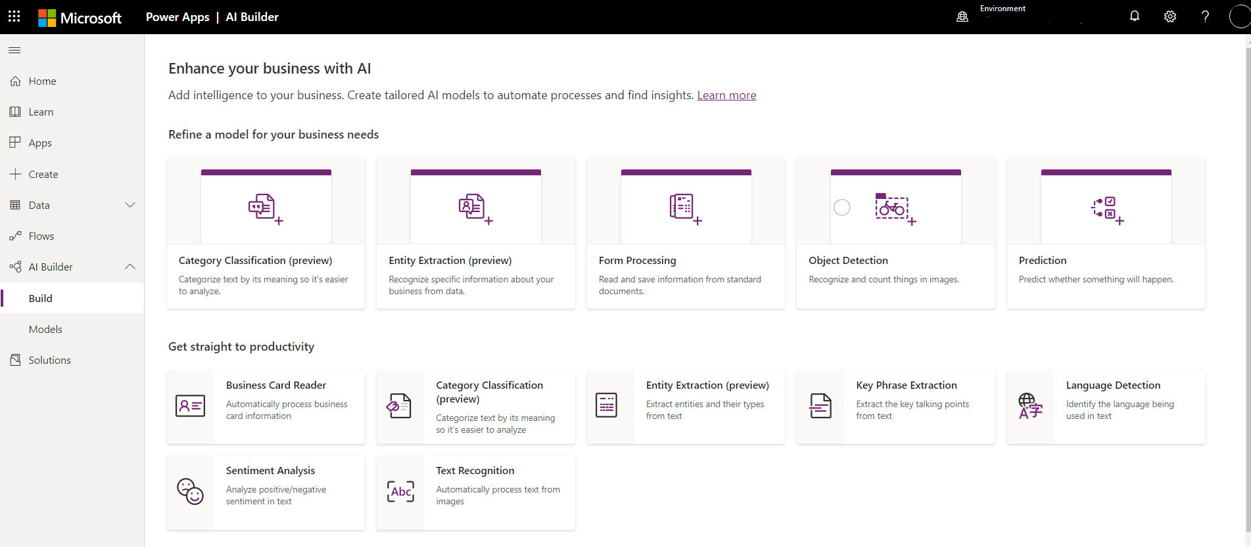
AI Builder

Slide 24
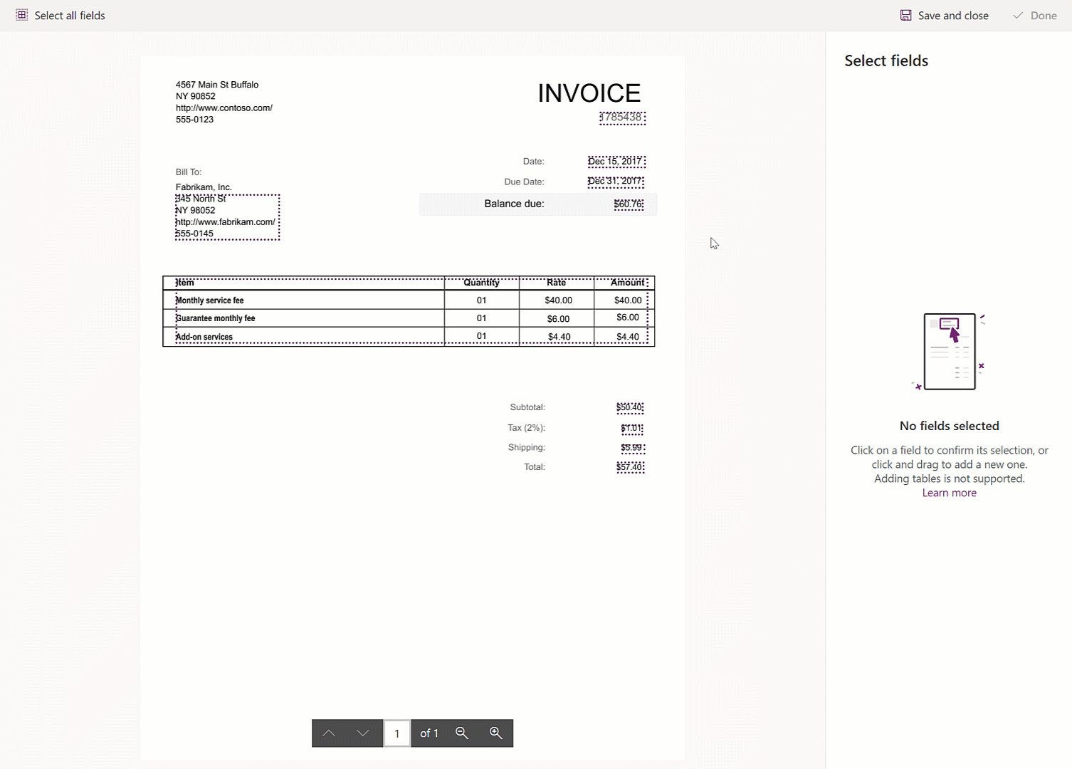
AI Builder

Slide 25
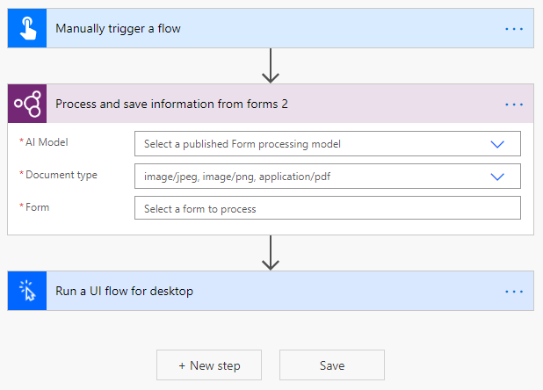
AI Builder

Slide 26
Automating Apps without APIs for our Modern World:
Automate Apps with Robotic Process Automation (RPA) Capabilities
Record the Task
Test the Task
Monitor the Task
Notes:
An RPA tool can learn to automate a task by watching the user perform that task in a graphical user interface (GUI), and then perform the automation by repeating those tasks directly in the GUI.

Slide 27
Power Automate With Attended and Unattended RPA
Attended
Unattended
Interactive automation
Background automation
Overview | Drive efficiencies and automate manual, individual tasks across desktop and web | Accelerate the automation of high-volume and tedious tasks without lifting a finger
Scenario | On-demand task automation | Automate company processes at scale
Audience | Citizen developer in business unit | Automation specialist (for now) in a Center of Excellence dedicated to RPA
Requirement | User signed in on their device/human initiated | Jobs on dedicated machines/robots do the work
Notes:
Power Automate will offer both attended and unattended RPA. Attended is in public preview from Nov 4th, 2019 while unattended will be available shortly after. Attended RPA requires some human intervention and the machine must be on or the user must be logged into the system. With unattended automation, the RPA bot can log into the system as part of the automation and no human assistance is required.

Slide 28

Diverse Toolset to run UI Flows
Windows 10 Apps
Web Apps
WinAutomation
Compatible with Windows 10 machines running 64-bit operating systems​
Based on the UI Automation framework​ and Image Recognition technologies
Now available!
Low code development environment
Diverse set of connectors to many different systems
Runs on the latest versions of Microsoft Edge (Chromium) and Google Chrome​
Based on Selenium​
Notes:
Power Automate is also built on a secure foundation. Power Automate leverages Azure Active Directory which is the most widely used enterprise identity and access management service. This ensures that conditional access policies are applied to individual identities ensuring that Power Automate users can only build Power Automates which can connect to apps and data that they have access rights to.
Power Automate also ensures all your data is encrypted. Encryption can help protect your data both at rest and in transit. Data requested and transmitted is encrypted in transit using HTTPS. Data transferred through the on-premises data gateway is encrypted. Data that users upload is typically sent to Azure Blob storage, and all metadata and artifacts for the system itself are stored in an Azure SQL database and Azure Table storage.
Finally, administrators can configure Data Loss Prevention policies to control the flow of data between different services in their flows and apps. These policies can block data from being sent to non-compliant systems even if the end user would have access to send this information manually.

Slide 29
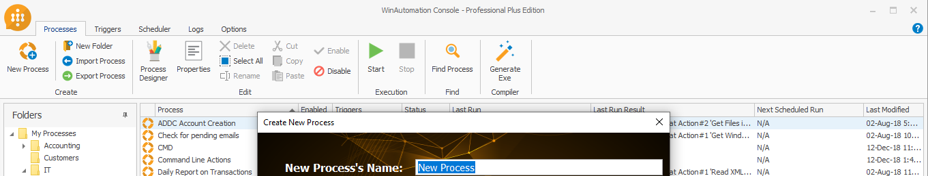
WinAutomation
Leading low-code RPA offering, used by thousands of customers
Thousands of features built over the last 15 years, including:
Expanded UI automation support including legacy terminals, Java apps, Citrix, etc.
Parallel execution and multi-tasking on same machine
Intelligent data extraction from multiple webpages
Available to Power Automate RPA customers today at no added cost (https://aka.ms/RPAbuild2020)

Slide 30
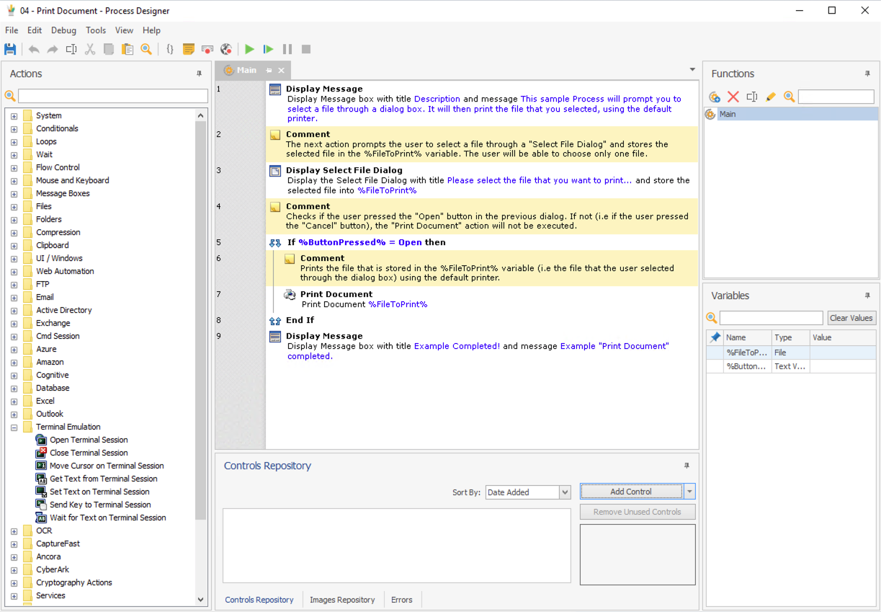
The WinAutomation Development Environment
Low-code canvas where you can drag-and-drop to build the logic you need for your automation
Build functions, variables, and controls that you can leverage from many different places
Action library everything from file manipulation to terminal emulation, and security features like CyberArk

Slide 31

Power Virtual Agents
New member of the Power Platform - https://powervirtualagents.microsoft.com
Create your own bots
Resolve routine issues quickly with highly personalized conversational bots
Reduce costs by automating repetitive queries
Empower bots to act
Compose conversational AI experiences
Easily integrate bots with hundreds of apps and services using prebuilt connectors or create custom workflows with Power Automate
Measure bot performance
Monitor and continuously improve bot performance using AI- and data-driven insights available in an easy-to-read dashboard.

Slide 32
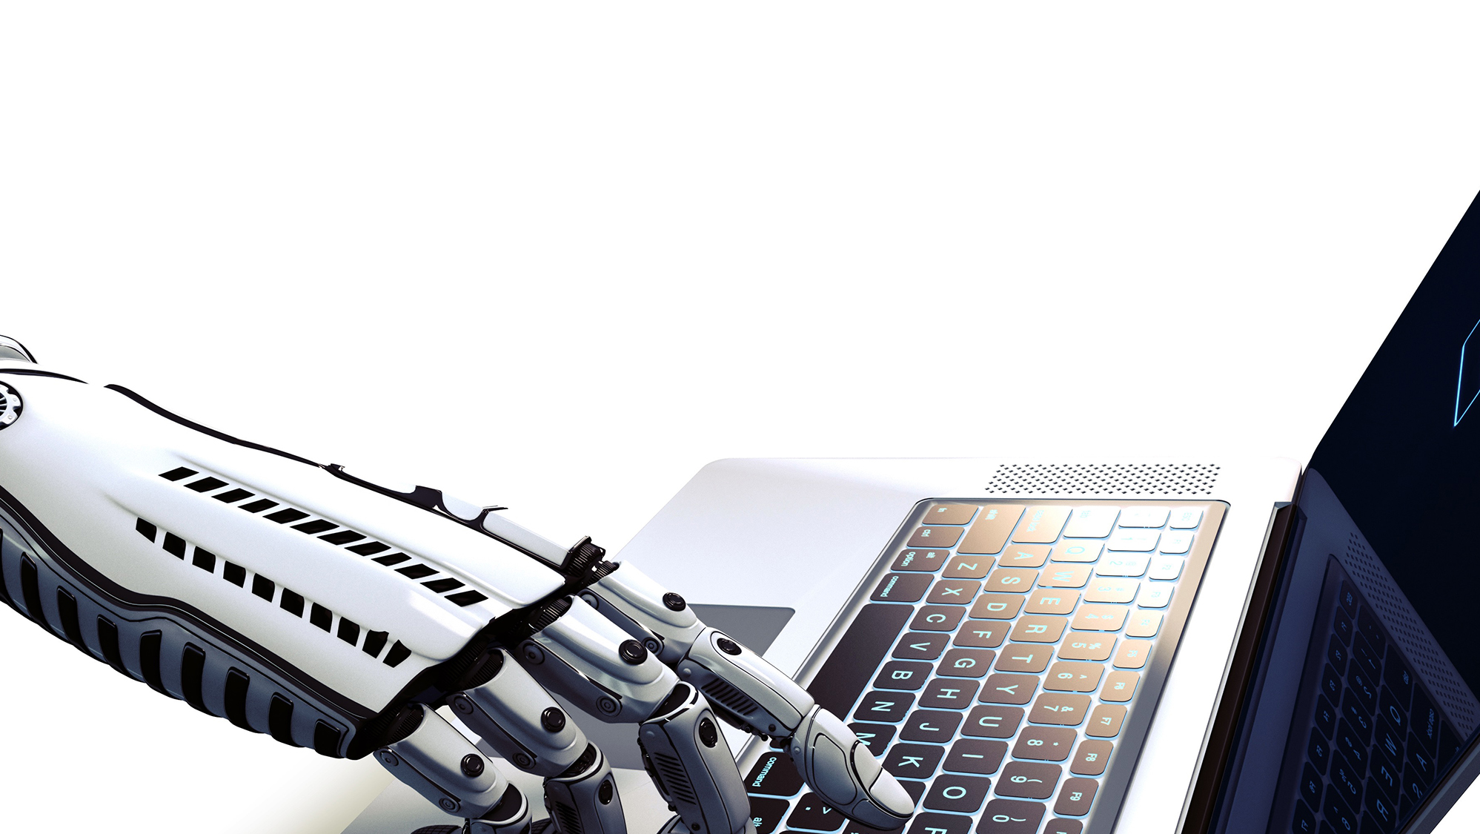
DIGITAL BUSINESS
AUTOMATION
What is RPA?
Robotic Process Automation is the innovative use of software to perform repetitive rules-based knowledge work across an organization as a substitute for, or aide to, human workers.
“Virtual Workers” replicate the specific actions a human would take while working with IT systems, the decisions they make, and the logical processes they follow, while interacting between different systems and applications.

Slide 33


45% of all work
activities can be automated
$2 trillion dollars
could be saved in workforce spending
6-9 Months
on average ROI for an RPA project
HOW IS RPA AFFECTING
THE WAY WE WORK?
94% of CEOs
that have incorporated RPA believe
that it has increased the productivity
By 2025
25% of jobs will be robotized

Slide 34



RPA
BUSINESS BENEFITS
Government and regulatory compliance
Virtual workforce 24x7x365
Productivity increase
Reduction of human errors
Flexibility
Cost reduction
Scalability
RAPID IMPLEMENTATION AND ROI
REDUCES THE NUMBER OF FTES IN A PROCESS

Slide 35


How RPA Works?
No significant change to the current IT infrastructure
No changes to existing interfaces
No need for a massive upfront investment
Reduces swivel chair integration
Robotic Process Automation is expected to save companies 50-70% on labor costs by making intelligent use of resources, near-zero error rates, improved compliance and reduced process cycle time, all of these through the implementation of machine learning and AI to develop/enhance procedures.
FOCUS ON ONLY JOBS HUMANS CAN DO
STRATEGY, CREATIVITY AND
CONNECTING WITH PEOPLE

Slide 36

RPA TYPICAL BUSINESS PROCESSES
RPA can learn from people, eventually taking over the processes that humans once completed, at a much faster pace.
Repetitive tasks Carried out 50-60
times a day
Process List
and Storage
Data Entry
Periodic reporting
and data analysis
Mass Email Generation
Archiving and extracting
Data Conversion
Conversion of data
format and graphics
ERP Transactions
ERP and other back
office transactions

Slide 37

Vision
From faces to feelings, allow your apps to understand images and video
Microsoft Cognitive Services
Give your apps a human side
Speech
Hear and speak to your users by filtering noise, identifying speakers, and understanding intent
Language
Process text and learn how to recognize what users want
Knowledge
Tap into rich knowledge amassed from the web, academia, or your own data
Search
Access billions of web pages, images, videos, and news with the power of Bing APIs

Slide 38
Record with Power Automate Desktop
Notes:
Introduce Power Automate Desktop
Record steps entering data in TimeChimp
Use variables for entries

Slide 39
Personalize and extend
Notes:
Create UI elements
Show capabilities about data retrieval, looping, UI interaction, etc.
Get data from Excel
Fill in TimeChimp using local experience with data from Excel

Slide 40
More control with Power Automate
Notes:
Use Power Automate to retrieve entries from Outlook
Call Power Automate Desktop for 3 customers
Fill in data for Contoso, Fabrikam and Northwind in TimeChimp (Website)
Fill in data for Fabrikam in Time Tracker (Windows application)
Fill in data for Northwind in Excel and send mail from Power Automate Desktop (Show Excel and Outlook capabilities and other possibilities)

Slide 41
Let AI help you
Notes:
Triggered from Virtual Agent
Call Power Automate Desktop
Export TimeChimp overviews to OneDrive per customer
Wait for files to arrive on OneDrive
Send both files using email with approval
Receive response from Contoso
Use cognitive services to check for signature set (using Logic Apps?)
If signature not set, notify user
If signature set, save to SharePoint and notify user

Slide 42
Use bots for natural communication
Notes:
Expense report uploaded
Use form recognizer to get total expenses
Use bot in Teams to ask manager for approval

Slide 43
Power Automate Desktop
Form Recognizer
Translate
Approval flow in Power Automate
Teams integration
Calling out to Azure Functions via APIM

Slide 44
Power Automate Desktop
Get hours from outlook or toggle or clockify
Depending on customer, write hours to specific system, twice in TimeChimp (one in day view, one in week view), once in desktop app
Record Web flow
Use parameters
Use custom fields

Slide 45



Thank You!
@egrootenboer
eldert@eldert.net
https://www.linkedin.com/in/eldert-grootenboer
Notes:
Rustig spreken!

